Slide 1


Selenium
User Extensions, RC and Web Driver
Anton Angelov
QA Engineer
SystemIntegrationTeam
Telerik QA Academy

Slide 2

Table of Contents
Selenium User Extensions
Principles and Usage
Selenium RC
Selenium WebDriver
Selenium Grid

Slide 3
Brief History of The Selenium
Started out around 2004 from Thoughtworks
WebDriver merged with Selenium
Selenium 1 used JavaScript to drive browsers
Selenium 2 was released

Slide 4

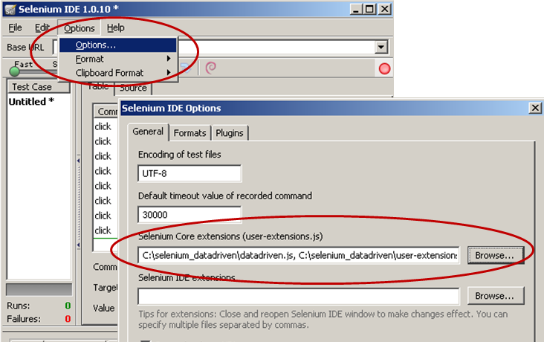
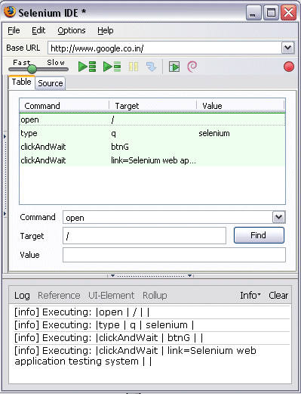

Selenium User Extensions

Slide 5
What Are User Extensions
User extensions
External .js files containing JavaScript functions
Suitable for multiple use of JavaScript snippets
Easier to change
Function’s design pattern
"do" tells Selenium that this function can be called as a command
Selenium.prototype.doFunctionName = function(){
.
.
.
}

Slide 6
What Are User Extensions
User extensions
Function’s design pattern
custom locator – all locateElementByFoo methods on the PageBot prototype are added as locator-strategies
Locates an element by a partial match on id
PageBot.prototype.locateElementByPartialId = function(text, inDocument)
{
return this.locateElementByXPath("//*[contains(./@id, 'Z')][1]".replace(/Z/,text), inDocument);
};

Slide 7
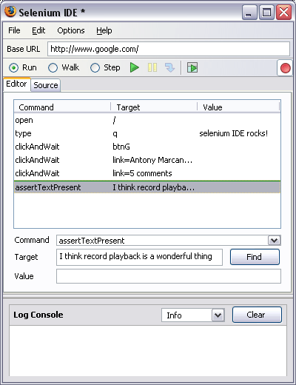
Selenium IDE Demo

Slide 8


Selenium 1 (Selenium Remote Control)

Slide 9
Selenium 1 (Selenium RC)
The main Selenium project for a long time
Before merging WebDriver and Selenium into Selenium 2
Selenium 1 is still actively supported
(mostly in maintenance mode)
Provides some features that are not yet available in Selenium 2
Support for several languages (Java, JavaScript, PRuby, HP, Python, Perl and C#)
Support for almost every browser

Slide 10
RC Components
The Selenium Server
Launches and kills browsers
Interprets and runs the Selenese commands passed from the test program
Acts as an HTTP proxy, intercepting and verifying HTTP messages passed between the browser and the AUT

Slide 11
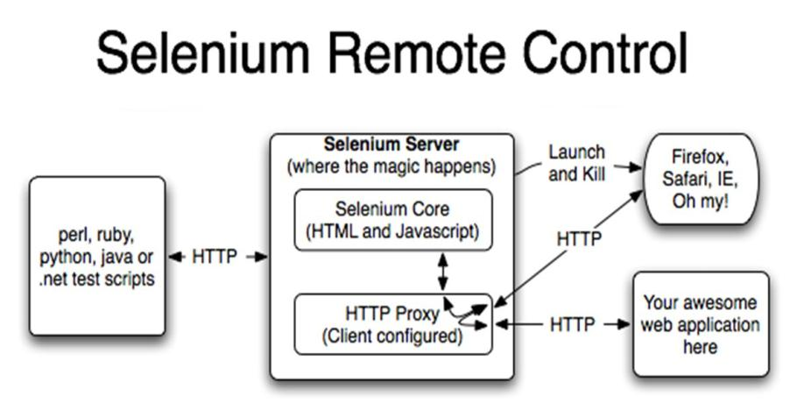
RC Components (2)

Slide 12
Selenium Server
Selenium Server
Receives Selenium commands from the test program
Interprets them
Reports back to your program the results of running those tests
Bundles Selenium Core and automatically injects it into the browser
When the test program opens the browser

Slide 13

Selenium-Core
Selenium-Core is a JavaScript program
A set of JavaScript functions
Interprets and executes Selenese commands using the browser’s built-in JavaScript interpreter

Slide 14
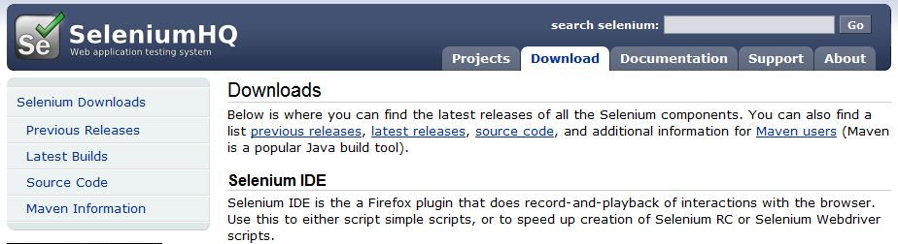
Installing Selenium RC
Selenium Server can be downloaded from:
http://seleniumhq.org/download/

Slide 15


Installing Selenium Server
The Selenium RC server is simply a Java jar file (selenium-server.jar),
Doesn’t require any special installation
Just download the zip file and extract the server in the desired directory

Slide 16

Running Selenium Server
Running Selenium Server requires Java Development Kit (JDK) to be installed on your machine and included in the class path
http://www.oracle.com/technetwork/java/javase/downloads/index.html
Use CMD
Navigate to the directory where Selenium RC’s server is located and run the following from a command-line console:
java -jar selenium-server.jar

Slide 17
Running Selenium IDE tests with Selenium RC
Using the –htmlsuite argument, we have managed to run our Selenium IDE tests through Selenium RC
java -jar "C:\Software\selenium-server-standalone-2.32.0.jar" -htmlsuite *firefox "http://www.book.store.bg" "D:\Selenium\TestSuite.html" "D:\Selenium\result.html"
The Base URL
Path to test suite
Path to test results

Slide 18
Selenium RC arguments
Most common Selenium RC arguments
port – since Selenium RC acts as a proxy between your tests and the application being tested, it has to use a port to listen for commands
userExtensions – we can access all the extra commands in our tests
firefoxProfileTemplate – if you require a special profile, or if you need to make sure that a specific Firefox Add-on is installed

Slide 19
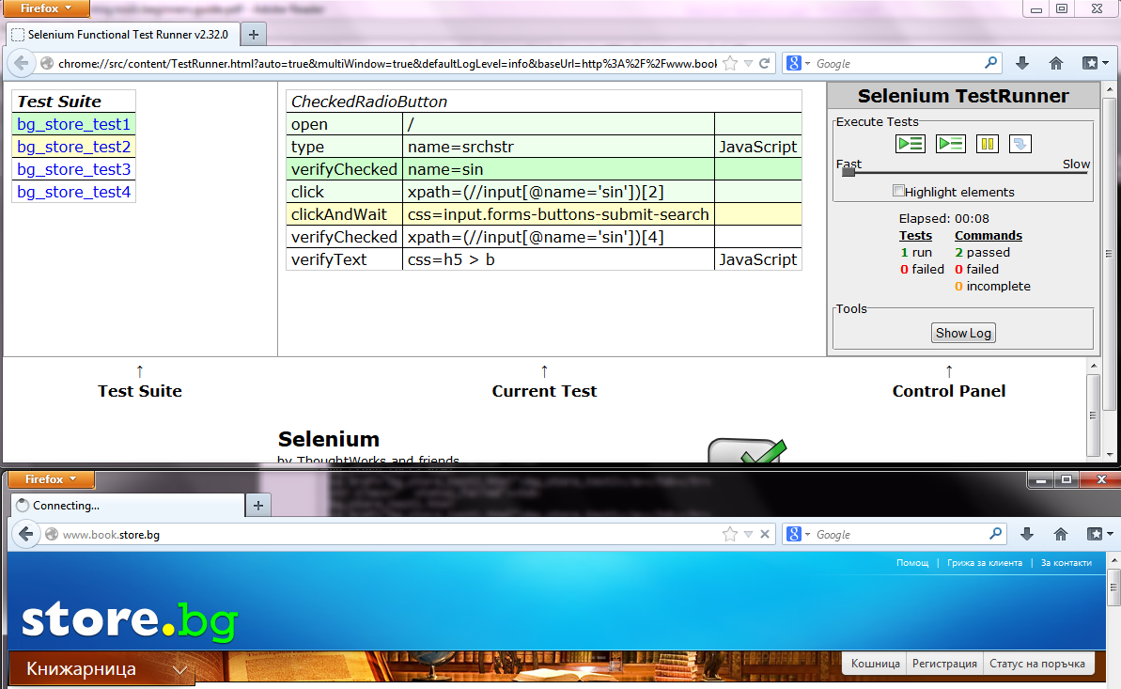
Selenium RC Benefits
Selenium Core Framework with the test suite
The test steps
The results

Slide 20
Test Suite results
When the tests have finished it will write the results to a file in a HTML format
showing which tests have passed or failed
the command that it may have failed on

Slide 21
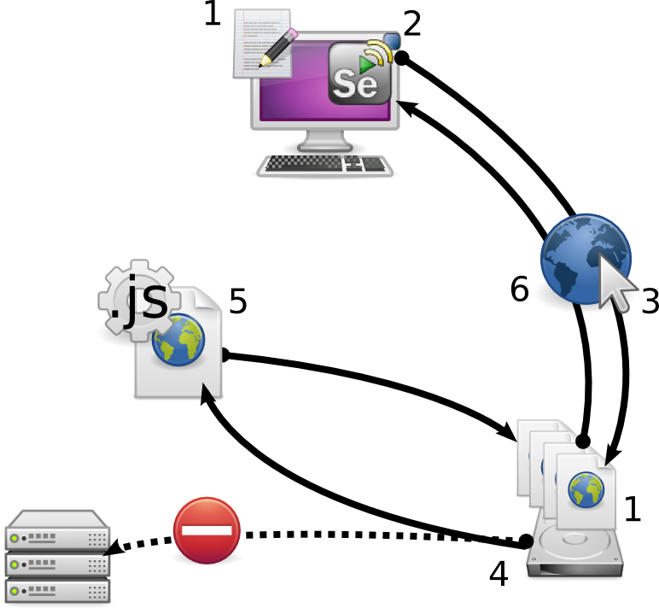
Selenium RC Demo

Slide 22
Selenium RC Benefits
Run the same set of tests on different code branches (and browsers) on daily basis in a continuous integration environment
Can be used for any Java Script enabled browser
Can be used to automate complex test cases
Makes it possible to create fast, robust and scalable automation

Slide 23
Why Selenium and WebDriver are being merged
Positive points
Works with any browser that supports JavaScript
More life-like interaction with the browser
Not bound by the JavaScript sandbox
Does not require a proxy between the test and the browser

Slide 24

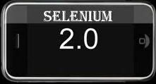
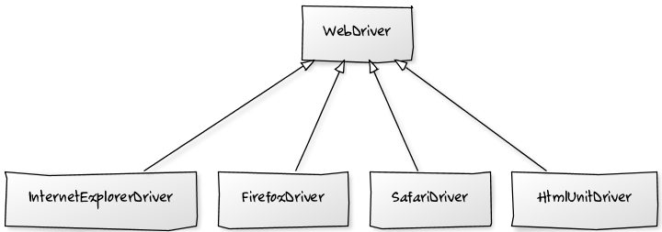
Selenium WebDriver

Slide 25
Why Use the WebDriver?
Selenium WebDriver
A tool for automating web application testing
Developed to better support dynamic web pages where elements of a page may change without the page itself being reloaded(AJAX)
Makes direct calls to the browser using each browser’s native support for automation the page itself being reloaded.

Slide 26
Selenium 1.0 + WebDriver = Selenium 2.0
Binding Code
(C#, Java …)
WebDriver Wire Protocol
Drivers
(IE, Firefox, Chrome …)

Slide 27
The WebDriver Wire Protocol
All implementations of WebDriver that communicate with the browser, or a Remote WebDriver server shall use a common wire protocol
The wire protocol defines a RESTful web service using JSON over HTTP
implemented in request/response pairs of "commands" and "responses"

Slide 28
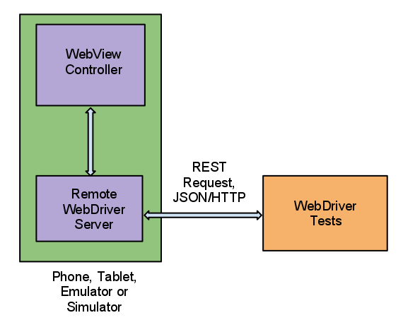
Rest Console Demo

Slide 29
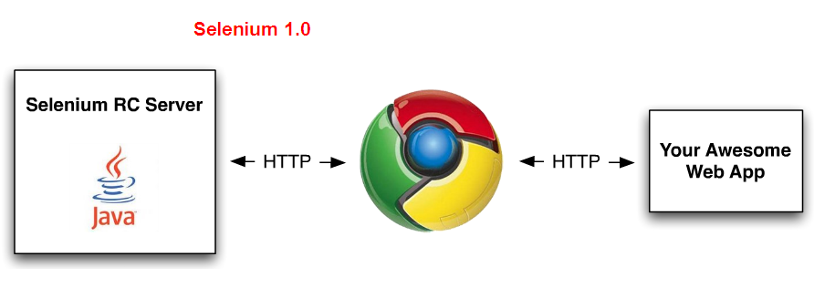
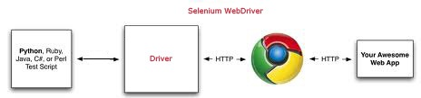
Selenium RC vs. WebDriver
Selenium-RC "injected" JS functions into the browser when the browser was loaded and then used its JS to drive the AUT within the browser
Selenium-WebDriver makes direct calls to the browser using each browser’s native support for automation

Slide 30
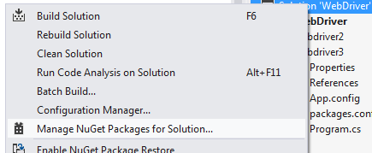

Setting Up WebDriver
Using NuGet packages
Create New Project in VS
Install NuGet package manager and navigate to it
Search for selenium and install the first item in the result list

Slide 31
Creating Driver
Create an instance of a driver
Note: additional steps are required to use Chrome Driver, Opera Driver, Android Driver and iPhone Driver
IWebDriver driverOne = new FirefoxDriver();
IWebDriver driverTwo = new InternetExlorerDriver();
Navigate to page
driver.Url = "http://www.google.com";

Slide 32
Getting Started
Choose and download browser driver you want to use for your tests (ex. Chrome)
The IWebDriver interface can be find under OpenQA.Selenium namespace
using OpenQA.Selenium;
usiOpenQA.Selenium.Chrome;
namespace WebDriverDemo
{
class Program
{
static void Main(string[] args)
{
IWebDriver driver = new ChromeDriver(@"C:\libraries");
driver.Url= "http://www.google.com";
}
}
}
You have to tell the WebDriver API where this ChromeDriverServer is located
Notes:
http://code.google.com/p/selenium/downloads/list

Slide 33
Locating Elements
Elements can be located by the same properties as in the IDE
By ID
IWebElement element = driver.FindElement(By.Id("coolestWidgetEvah"));
By Class
IList<IWebElement> cheeses = driver.FindElements(By.ClassName("cheese"));
By Tag Name
IWebElement frame = driver.FindElement(By.TagName("iframe"));

Slide 34
Locating Elements(2)
By Name
IWebElement cheese = driver.FindElement(By.Name("cheese"));
By Link Text
IWebElement cheese = driver.FindElement(By.LinkText("cheese"));
By XPath
IList<IWebElement> inputs = driver.FindElements(By.XPath("//input"));
By CSS Selector
IWebElement cheese = driver.FindElement(By.CssSelector("#food span.dairy.aged"));

Slide 35
Wait Steps
Explicit wait
WebDriverWait wait = new WebDriverWait(driver, TimeSpan.FromSeconds(10));
IWebElement myDynamicElement = wait.Until<IWebElement>((d) => { return d.FindElement(By.Id("someDynamicElement")); });
Implicit wait
driver.Manage().Timeouts().ImplicitlyWait(TimeSpan.FromSeconds(10));

Slide 36
Type Text
Type Text into a field using Selenium WebDriver SendKeys() function
// Find the text input element by its name
IWebElement element = driver.FindElement(By.Name("search"));
// Enter something to search for
element.SendKeys("telerik");

Slide 37
Verify Text Steps
WebDriver does not support the well-known commands of Selenium IDE like verifyTextPresent
We can implement so
public static void AssertTextPresent(String value)
{
if (!driver.PageSource.Contains(value))
{
throw new Exception(value + " is not present");
}
}

Slide 38
Asserts
There wasn’t any built-in method to assert text on a page
You can do something along the lines of
static void Main(string[] args)
{
IWebDriver driver = new ChromeDriver(@"C:\libraries");
driver.Url= "http://www.google.com";
Assert.AreEqual("Google", driver.Title);
}

Slide 39
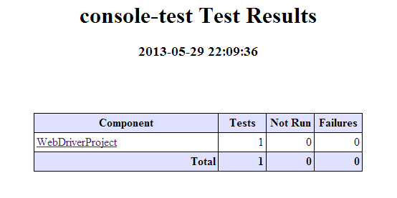
Reporting Results
The test results are limited by the Unit Testing Framework we use
ex. NUnit, VS Test Team, Gallio
Uning NUnit-Results

Slide 40
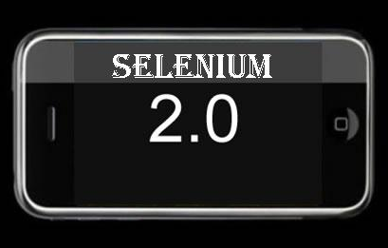
Web Driver Demo

Slide 41
C# Formatters
Plugins for Selenium IDE
add WebDriver backed Selenium formatters
allows users to take advantage of WebDriver without having to modify their tests
https://addons.mozilla.org/en-US/firefox/addon/webdriver-backed-formatters/

Slide 42
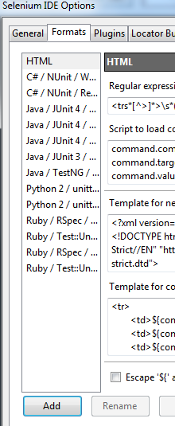
Custom Format
You can add any format you like by writing JavaScript code
Open Options dialog ->"Options…" in the menu bar -> "Formats" tab
Create a new format by clicking "Add" button
There are 3 empty functions
parse
format
formatCommands

Slide 43
Custom Format (3)
The "parse" function is almost opposite of "format". This function parses the String and updates test case
function parse(testCase, source) {
var doc = source;
var commands = [];
while (doc.length > 0) {
var line = /(.*)(\r\n|[\r\n])?/.exec(doc);
var array = line[1].split(/,/);
if (array.length >= 3) {
var command = new Command();
command.command = array[0]; command.target = array[1];
command.value = array[2]; commands.push(command);
}
doc = doc.substr(line[0].length);
}
testCase.setCommands(commands);
}

Slide 44
Custom Format (4)
The "formatCommands" function is similar to "format" function, but is used to copy part of the test case into the clipboard
function formatCommands(commands) {
var result = '';
for (var i = 0; i < commands.length; i++) {
var command = commands[i];
if (command.type == 'command') {
result += command.command + ',' + command.target + ',' + command.value + "\n";
}
}
return result;
}
'ext.Driver.Navigate().GoToUrl("' + command.target.toString() + '");';

Slide 45
Custom Format (2)
The "format" function creates an array of commands contains command object (Command, Target, Value)
function format(testCase, name) {
var result = '';
var commands = testCase.commands;
for (var i = 0; i < commands.length; i++) {
var command = commands[i];
if (command.type == 'command') {
result += command.command + ',' + command.target + ',' + command.value + "\n";
}
}
return result;
}
return formatCommands(testCase.commands);

Slide 46
Refactoring for Page Object Model
The PageFactory class is an extension to the PageObject design pattern
Install Selenium WebDriver Support Classes package
private IWebDriver driver;
[FindsBy(How = How.Id, Using = "SearchTerm")]
private IWebElement Search; // How.Id = SearchTerm
[FindsBy(How = How.Id, Using = "SearchButton")]
private IWebElement Button;
public FindUsersPage Do(string UserName)
{
Search.SendKeys(UserName);
Button.Click();
PageFactory.InitElements(driver, (new FindUsersPage(this.driver)));
return new FindUsersPage(driver);
}
FindUsersPage PageObject must be created
The InitElements method of PageFactory initializes the elements of the PageObject

Slide 47
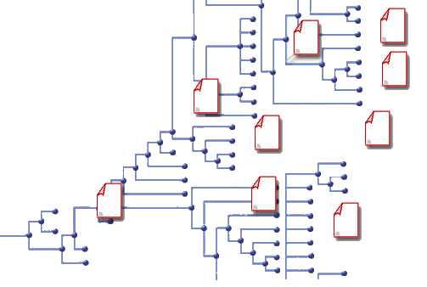
Page Object Model Demo

Slide 48
Selenium-Grid
Selenium-Grid allows you run your tests on different machines against different browsers in parallel
Selenium
Test
Hub
Node
Node
Node
Drivers
Drivers
Drivers

Slide 49


Selenium Grid Demo

Slide 50
Selenium
?
?
?
?
?
Questions?
?
?
?
?
?
?

Slide 51
Exercises
Create Automated Selenium Test for Log in in http://www.telerikacademy.com/.
Use logical steps and appropriate validations to create a good test.
Create .bat file to run your test under different browsers, don’t forget to include the user extension you used for the logical steps.
Export your test to WebDriver and run it (use NUnit or Gallio).

